Slide 1
Problem solving with integers and decimals
Arithmetic procedures with integers and decimals

Slide 2
how to use Oak lessons

Slide 3
I can use my knowledge of calculating with integers and decimals to solve problems.

Slide 4
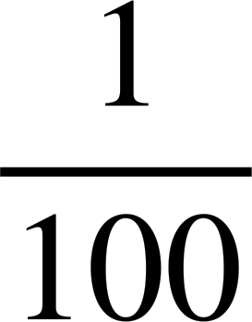
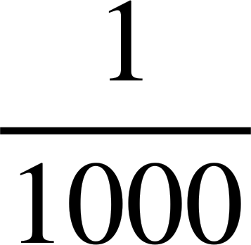
An integer is any positive or negative whole number or zero.
The additive inverse of a number is a number that, when added to the original number, gives the sum of 0.
Centi placed before a unit means .
Milli placed before a unit means .
Kilo placed before a unit means 1000 times.

Slide 5

Problem solving with integers and decimals
Integers, negatives and decimals in the real world
Measurements and accuracy

Slide 6
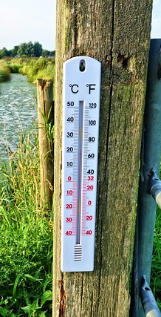
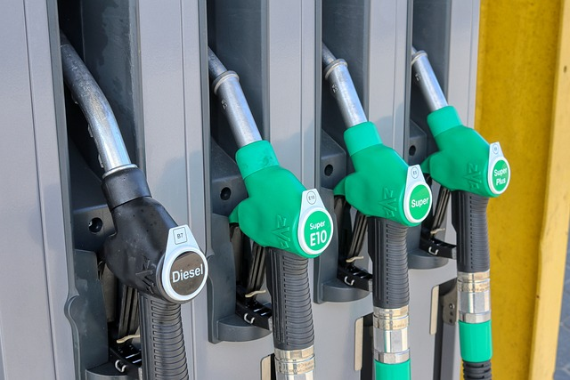
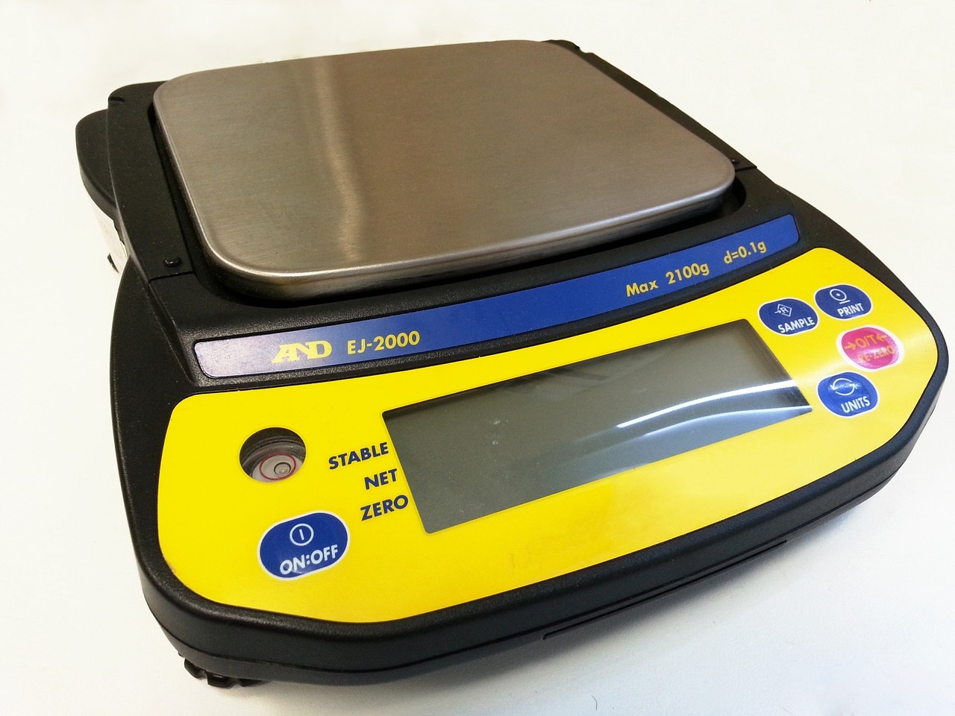
Integers, negatives and decimals in the real world
Decimals and integers are used so much in the real world.
Can you think of some examples of some real life decimal numbers you have possibly seen today?
There are so many real life examples! Here are just a few.
Price of petrol
Weighing ingredients
Temperature

Slide 7
Integers, negatives and decimals in the real world
Without calculating or working out the answer, which operation (+, -, × or ÷) are we applying to this question?
Lucas goes camping with his family. On Saturday morning the temperature was -4.7℃. On Sunday morning the temperature was 8.9℃.
He wants to find out the difference in temperature from the Saturday morning to the Sunday morning.

Slide 8
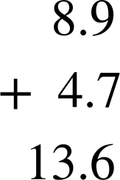
Integers, negatives and decimals in the real world
It is subtraction.
This means our calculation is 8.9 − (-4.7)
Using additive inverses we have 8.9 + (+4.7)
Show your working out to work out the difference in temperature between Saturday and Sunday morning.
The difference is 13.6℃

Slide 9

Integers, negatives and decimals in the real world
Without calculating or working out the answer, which operation (+, -, × or ÷) are we applying to this question?
A school uses a cashless thumb print machine for students to buy food and drink in school.
Laura has £3.76 credit in her account. She spends £2.34 and then spends another £1.27.

Slide 10
Integers, negatives and decimals in the real world
It is subtraction because she “spends”.
This means our calculation is 3.76 − 2.34 − 1.27
A school uses a cashless thumb print machine for students to buy food and drink in school.
Laura has £3.76 credit in her account. She spends £2.34 and then spends another £1.27.

Slide 11
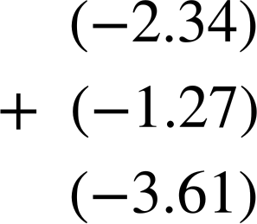
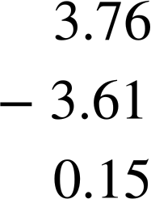
Integers, negatives and decimals in the real world
It is subtraction because she “spends”.
Using additive inverses we have 3.76 + (-2.34) + (-1.27)
Summing the negatives
1
Laura only has £0.15 left in her account.

Slide 12
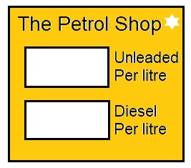
Integers, negatives and decimals in the real world
Without calculating or working out the answer, which operation (+, -, × or ÷) are we applying to this question?
An Oak Academy teacher fills up their car with 23 litres of unleaded petrol. How much does it cost?
£1.56
It is multiplication.
£1.86
The calculation is 1.56 × 23
Using the multiples of 10 strategy,
we can calculate 156 × 23 × 0.01

Slide 13
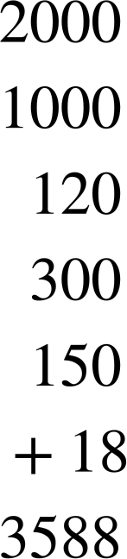
Integers, negatives and decimals in the real world
It is multiplication.
Using the multiples of 10 strategy, we can calculate 156 × 23 × 0.01
× | 100 | 50 | 6
20 | 2000 | 1000 | 120
3 | 300 | 150 | 18
£1.56
£1.86
156 × 23 = 3588
156 × 23 × 0.01 = 35.88
This means the teacher will pay £35.88

Slide 14
Integers, negatives and decimals in the real world
Sometimes we are required to use a combination of operations to solve problem solving questions.
There are lots of different ways to calculate an answer. Do not worry if your method is slightly different as long as the right answer is obtained.
A structured approach to problem solving questions is essential.

Slide 15
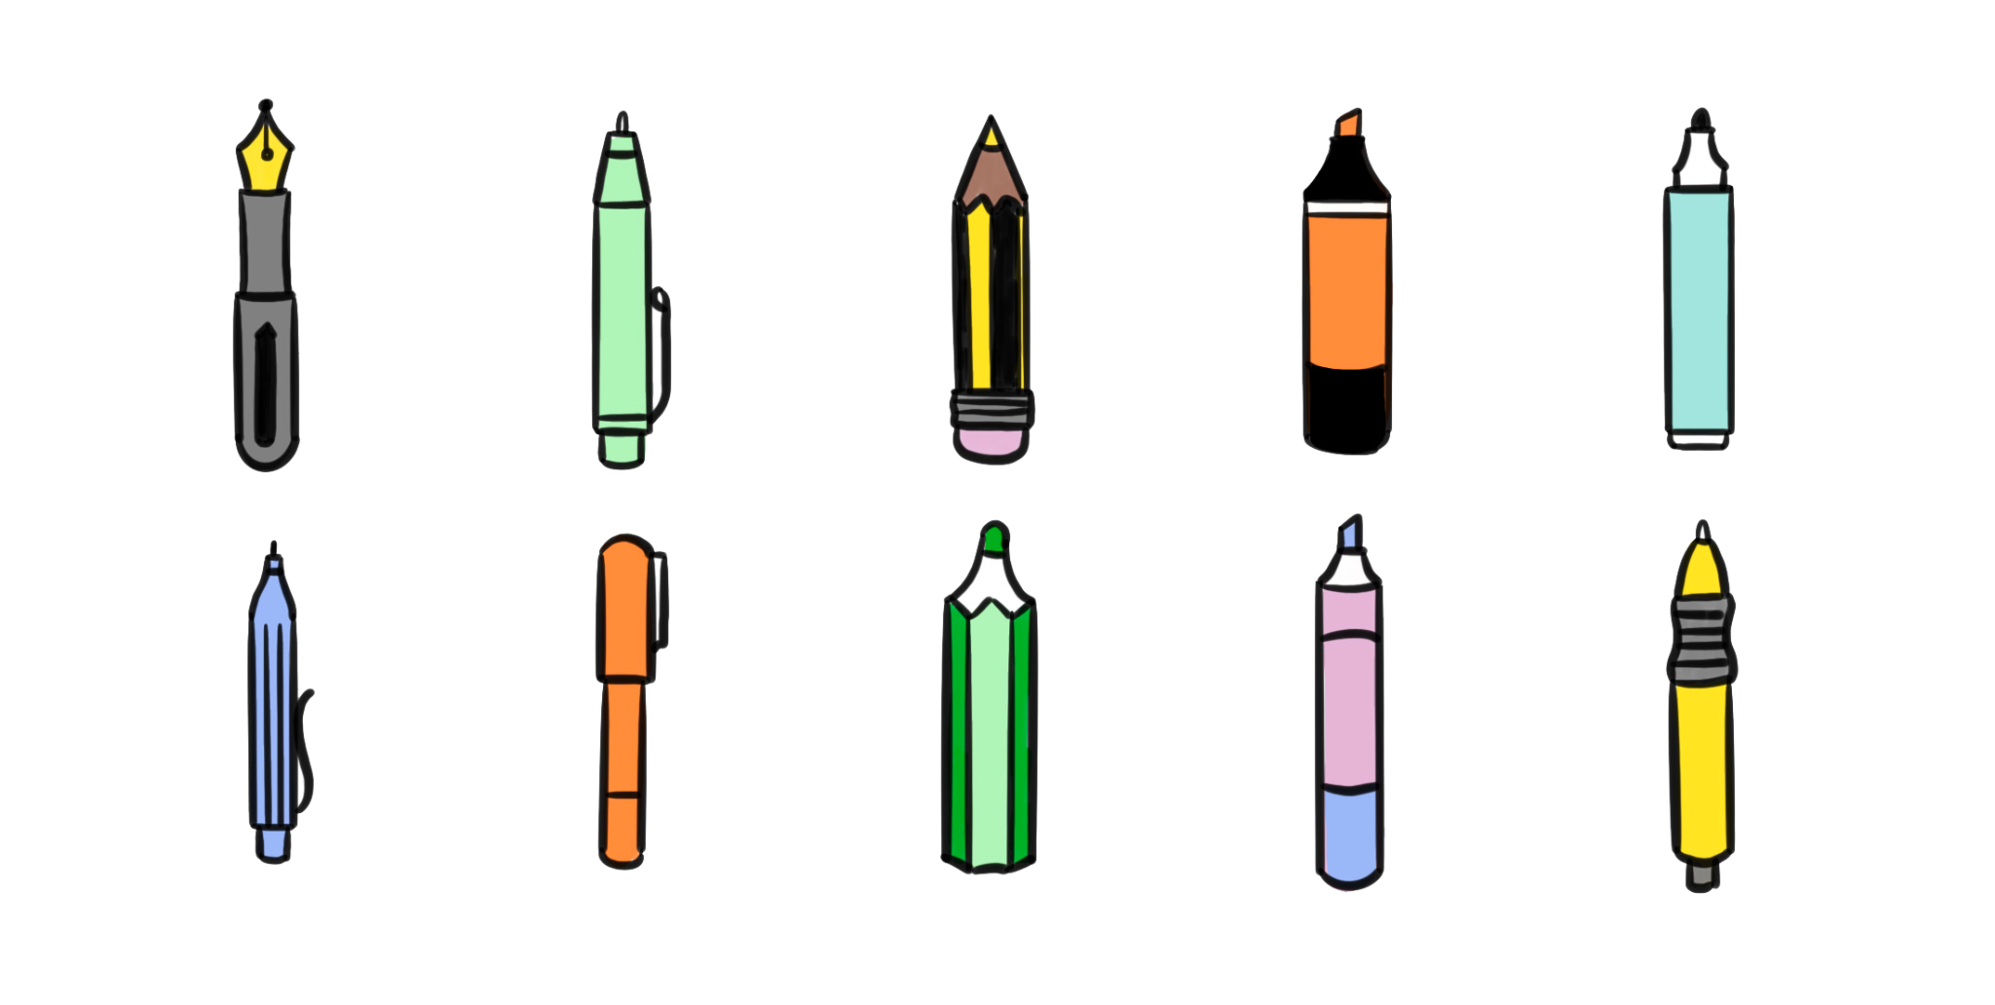
Integers, negatives and decimals in the real world
Sometimes we are required to use a combination of operations to solve real world problems.
Example
A shop sells pens and pencils. Izzy buys 3 pencils and 4 pens with a £10 note. What operations are we using to calculate how much change she receives?
76p
£1.56
We are using multiplication and then subtraction.

Slide 16
Integers, negatives and decimals in the real world
Show all your working out and calculate how much change Izzy receives from her £10 note.
Example
A shop sells pens and pencils. Izzy buys 3 pencils and 4 pens with a £10 note.
3 × 0.76 =
0.70 × 3 + 0.06 × 3 =
2.10 + 0.18 = 2.28
76p
£1.56
4 × 1.56 =
2 × 2 × 1.56 = 2 × 3.12 =
6.24
10 - (6.24 + 2.28) = 10 - 8.52
= 1.48
Izzy receives £1.48 change.

Slide 17
Integers, negatives and decimals in the real world
Without calculating or working out the answer, which operations (+, -, × or ÷) are we applying to this question?
Sam wants to work out the mean average time spent on Maths homework. Sam asks her 8 friends across the world how many hours they spend on their homework each week.
8.3 | 3.5 | 1.2 | 3.22 | 8 | 4.5 | 4.25 | 3.75

Slide 18
Integers, negatives and decimals in the real world
We are using both addition and division.
To calculate the mean we sum the values and divide by the number of values.
Work out the mean number of hours Sam’s 8 friends spend on their homework. Ensure to show all your working out.
8.3 | 3.5 | 1.2 | 3.22 | 8 | 4.5 | 4.25 | 3.75

Slide 19

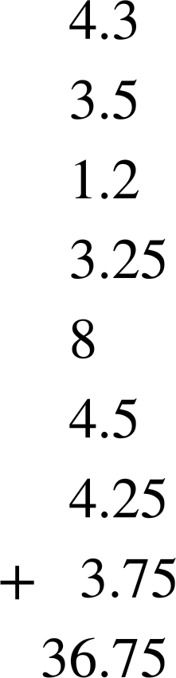

Integers, negatives and decimals in the real world
We are using both addition and division.
To calculate the mean we sum the values and divide by the number of values.
0
4
5
.
9
⟌
7
3
8
4
36.72
The mean hours spent on homework is 4.59 hours.
2
1

Slide 20
Integers, negatives and decimals in the real world
Aisha has £13.45 credit on her school account. She spends £2.67 then spends £7.89. Aisha then puts £4.21 back into her account.
How much does Aisha have in her school account now?
2) Jun has a £20 note. He buys 4 green pens, 6 pencils and 2 orange highlighters.
The shopkeeper gave Jun £6.16 in change.
Is this correct? Show your working out.
£1.56
76p
£1.27

Slide 21
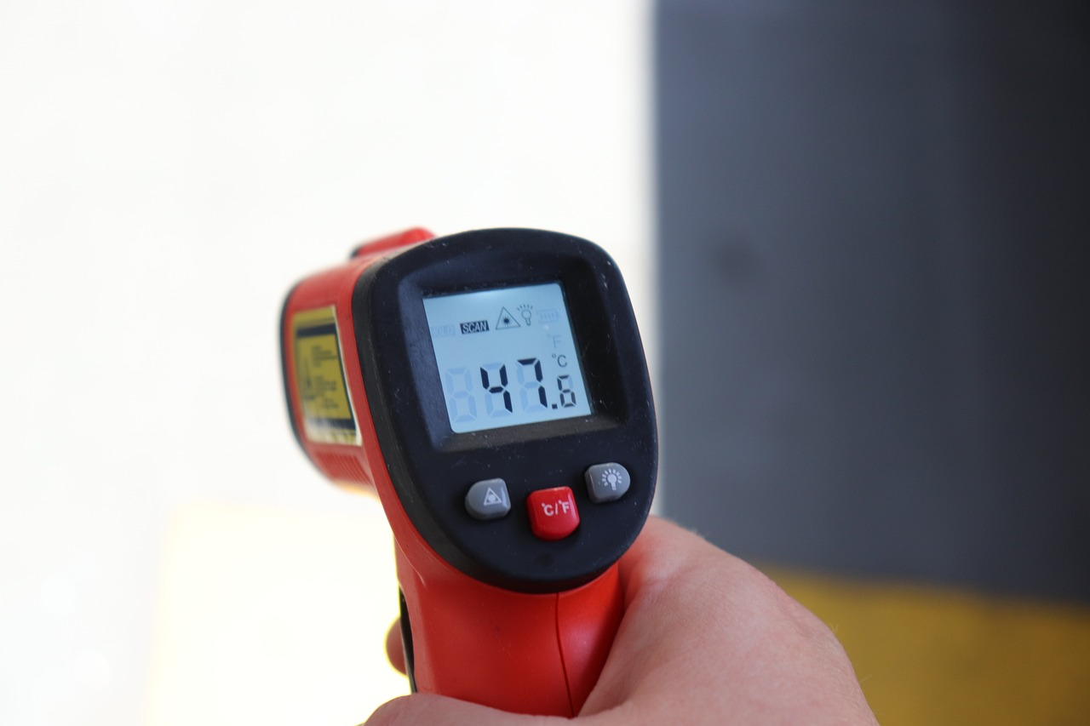
Integers, negatives and decimals in the real world
3) There are two places in Antarctica scientists want to investigate. They look at the temperature in the morning over 5 days.
Location 1 | −24.3℃ | −21.6℃ | −20.9℃ | −24.15℃ | −24.8℃
Location 2 | −22℃ | −21℃ | −26℃ | −24℃ | −24.8℃
Using the mean average, which is the coldest location?

Slide 22

Integers, negatives and decimals in the real world
4) Andeep is taking part in a local Maths competition.
There are 10 questions.
Each correct answer gets 8 points.
Each incorrect answer gets (-6) points.
Each question not answered gets (-2) points.
Andeep answers 4 correct, 3 incorrect and does not answer 2 questions. How many points does he have?

Slide 23
Integers, negatives and decimals in the real world
4) b) In a different competition, Lucas gets 36 points.
There are 8 questions.
Each correct answer gets 12 points.
Each incorrect answer gets (-4) points.
Each question not answered gets (-2) points.
Give some examples of how Lucas performed in the competition.

Slide 24
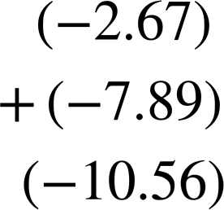
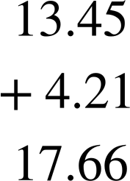
Integers, negatives and decimals in the real world
Aisha has £13.45 credit on her school account. She spends £2.67 then spends £7.89. Aisha then puts £4.21 back into her account.
How much does Aisha have in her school account now?
Negatives
Positives
13.45 − 2.67 − 7.89 + 4.21 =
13.45 + (-2.67) + (-7.89) + 4.21 =
1
1
1
17.66 + (-10.56) = 7.1
Aisha has £7.10 left

Slide 25
Integers, negatives and decimals in the real world
2) Jun has a £20 note. He buys 4 green pens, 6 pencils and 2 orange highlighters.
The shopkeeper gave Jun £6.16 in change.
Is this correct? Show your working out.
£1.56
76p
£1.27
4 × 1.56 =
2 × 2 × 1.56 = 2 × 3.12 =
6.24
6 × 0.76 =
3 × 0.76 × 2 =
2.28 × 2 = 4.56
2 × 1.27 = 2.54
6.24 + 4.56 + 2.54 = 13.34
20 - 13.34 = 6.66
The change is incorrect. Jun should get £6.66

Slide 26
Integers, negatives and decimals in the real world
3) There are two places in Antarctica scientists want to investigate. They look at the temperature in the morning over 5 days.
Location 1 | −24.3℃ | −21.6℃ | −20.9℃ | −24.15℃ | −24.8℃
(−24.3) + (−21.6) + (−20.9) + (−24.15) + (−24.8) = (−115.75)
(−115.75) ÷ 5 = (−115.75) ÷ 10 × 2 = (−11.575) × 2 = (−23.15)
Location 2 | −22℃ | −21℃ | −26℃ | −24℃ | −24.8℃
(−22) + (−21) + (−26) + (−24) + (−24.8) = (−117.8)
(−117.8) ÷ 5 = (−117.8) ÷ 10 × 2 = (−11.78) × 2 = (−23.56)
Location 2 is slightly colder on average than location 1.

Slide 27
Integers, negatives and decimals in the real world
4) Andeep is taking part in a local Maths competition.
There are 10 questions.
Each correct answer gets 8 points.
Each incorrect answer gets (-6) points.
Each question not answered gets (-2) points.
Andeep answers 4 correct, 3 incorrect and misses 2 questions. How many points does he have?
4 × 8 + 3 × (-6) + 2 × (-2) =
32 + (-18) + (-4) =
32 + (-22) = 10
Andeep has 10 points.

Slide 28
Integers, negatives and decimals in the real world
4b) In a different competition, Lucas gets 36 points.
There are 8 questions.
Each correct answer gets 12 points.
Each incorrect answer gets (-4) points.
Each question not answered gets (-2) points.
Give some examples of how Lucas performed in the competition.
Example
4 × 12 + 2 × (-4) + 2 × (-2) = 36
4 correct, 2 incorrect and 2 missed.

Slide 29
Problem solving with integers and decimals
Integers, negatives and decimals in the real world
Measurements and accuracy

Slide 30
Measurements and accuracy
We use decimals with measurements to increase the accuracy.
This level of accuracy is important in so many different fields of expertise: medicine, engineering, biochemistry, construction, etc.

Slide 31
Measurements and accuracy
When applying operations to measurements, it is sometimes necessary to have all the units the same.
Knowing the prefixes can help convert to the same unit.
Centi placed before a unit means
Milli placed before a unit means
Kilo placed before a unit means 1000 times.

Slide 32
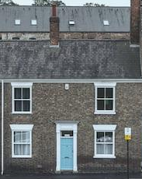
Measurements and accuracy
Three builders measured different parts of a house.
Builder A measured the first section to be 2.56 m
Builder B measured the second section to be 245 cm
Builder C measured the third section to be 3890 mm
The owner wants the length of the house in metres.
What do you think the builders need to do?
2.56m
245cm
3890mm

Slide 33
Measurements and accuracy
Convert all lengths to metres.
= 2.56 m
2.56 m
245 cm
= 2.45m
3890 mm
= 3.89 m
The owner wants the length of the house in metres.
What do you think the builders need to do?
2.56m
245cm
3890mm

Slide 34
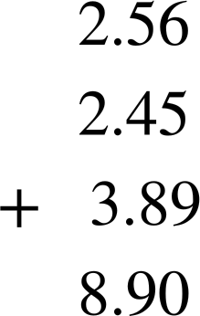
Measurements and accuracy
Add all the numbers as they are now in the same units
= 2.56 m
2.56 m
245 cm
= 2.45m
245 cm
3890 mm
= 3.89 m
1
2
The length of the house is 8.9 m
2.56m
245cm
3890mm

Slide 35
Measurements and accuracy
ONLY SELL 1 m lengths
The house needs new guttering along the roof.
The guttering will be the same length as the length of the house. The guttering costs £32 per metre.
Work out the cost of the guttering, ensuring to show all your working out.
The calculation is 32 × 9 =
= 320 - 32
= 288
8.9 m
The cost for the guttering is £288.

Slide 36
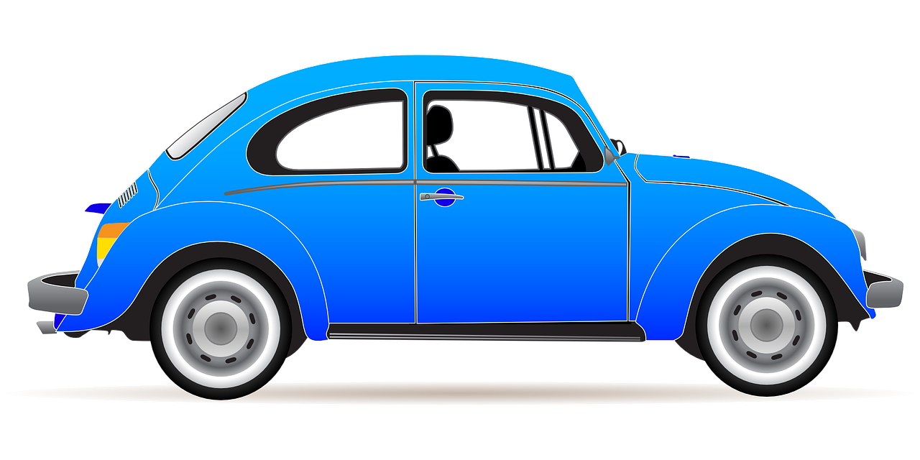
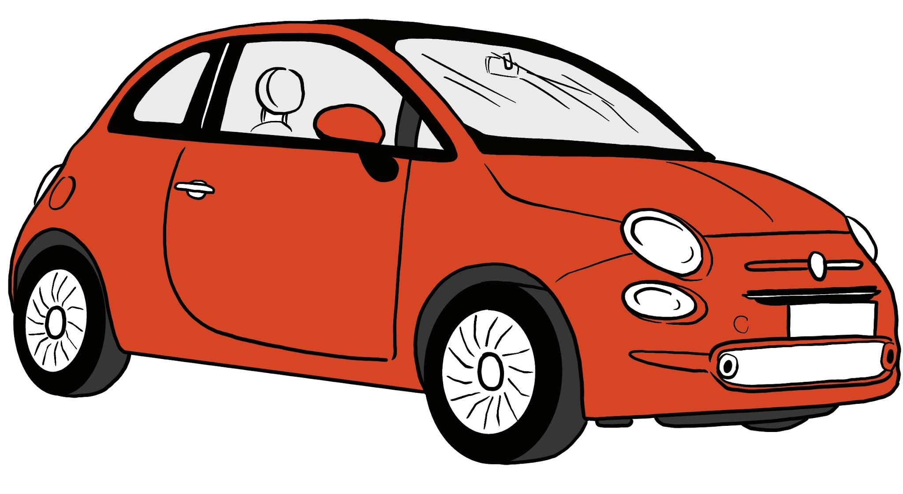
Measurements and accuracy
Here is an example of two car rental companies.
Rent-a-Red-Car
1 km = £0.46
Rent-a-Blue-Car
2500 m = £1.10
An Oak teacher knows he will need to rent a car for a 70 km journey. Work out the difference in prices between the two companies for a 70 km car hire.

Slide 37

Measurements and accuracy
2) Sofia helps her neighbour feed her cats using a feeding chart.
Mass to the nearest 10 g | Quantity of dry food per day
🐱 1 - 2.99 kg | 70 g
🐱 3 - 4.99 kg | 90 g
🐱 5 - 5.99 kg | 100 g
🐱 more than 6 kg | 115 g
1.5 kg of dry food
£9.82
Her neighbour has three cats weighing 4.5 kg, 5.1 kg and 6.2 kg.
How much will it cost to feed all three cats for 2 weeks?

Slide 38
Measurements and accuracy
1)
Rent-a-Red-car
0.46 × 70 =
4.6 × 7 =
32.20
Rent-a-Blue-car
2500 m = 2.5 km
Rent-a-Red-Car
1 km = £0.46
Rent-a-Blue-Car
2500 m = £1.10
70 ÷ 2.5 =
700 ÷ 25 =
28
28 × 1.1 =
28 × 11 × 0.1 =
30.8
£32.20 - £30.80 = £1.40
An Oak teacher knows he will need to rent a car for a 70 km journey. Work out the difference in prices between the two companies for a 70 km car hire.

Slide 39
Measurements and accuracy
2) Sofia helps her neighbour feed her cats using a feeding chart.
Mass to the nearest 10 g | Quantity of dry food per day
🐱 1 - 2.99 kg | 70 g
🐱 3 - 4.99 kg | 90 g
🐱 5 - 5.99 kg | 100 g
🐱 more than 6 kg | 115 g
1.5 kg of dry food
£9.82
Her neighbour has three cats weighing 4.5 kg, 5.1 kg and 6.2 kg.
How much will it cost to feed all three cats for 2 weeks?

Slide 40
Measurements and accuracy
2) Sofia helps her neighbour feed her cats using a feeding chart.
4.5 kg cat requires 90 g per day
5.1 kg cat requires 100 g per day
6.2 kg cat requires 115 g per day
Total food per day is 90 + 100 + 115 = 305 g per day
For 2 weeks it is 305 × 14 = 4270 g
1.5 kg of dry food
£9.82
1.5 kg = 1500 g
She will need 3 bags.
9.82 × 3 = £29.46 needs to be spent on cat food.

Slide 41
Problem solving with integers and decimals
It is important we can use our skills on addition, subtraction, multiplication and division in the real world.
It is equally important when we know which operation to apply given the context of the question.
We use decimals with measurements to increase the accuracy.
This level of accuracy is important in so many different fields of expertise: medicine, engineering, biochemistry, construction, etc.

Slide 42

© Oak National Academy 2023.
Produced in partnership with Mathematics in Education and Industry.
Licensed on the Open Government Licence v3.0, except where otherwise stated. See Oak terms and conditions.

